Slide 1

Welcome
Shopping Behavior Analysis
Barbara Klimova, Aleem Shaikh
Brain Station - Data Analytics Certificate

Slide 2
Agenda
Hypothesis formulation
Data Cleansing & Organization
Analysis of findings
Visualization of the storyline

Slide 3
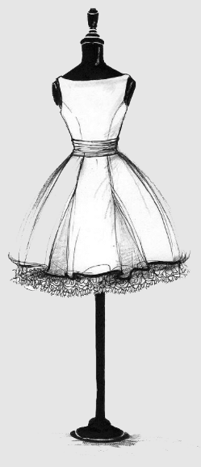

The Problem Statement
Target Purpose
The Head of Sales would like to…
Understand their consumer demographic trends to establish a sales strategy for NTB
Set promotions by seasonal trends
The Head of MKT would like to…
Send out targeted promotional EDMs to potential subscribers
Send out targeted promotional EDMs by shopping behavior
BOTH would like to
Introduce rewards program for potential subscribers based on purchasing patterns
Dress
to
Impress
Basic to premium clothing & accessories
Target Audience
The Marketing & Sales teams at Dress to Impress has an interest to scale their e-com business into further product lines.
Target Focus
The focus is on on evaluating seasonality and consumer trends by demographic profile based on age, gender and shopping behaviour patterns.
Notes:
Barbara: The Marketing & Sales team at Dress to Impress has shopping behavior of customers of the Dress to Impress online store based on age, gender, season, rating, shipping method and payment method .

Slide 4
Hypothesis
Older customers tend to spend more per purchase than younger customers.
Subscribed customers have higher purchase frequency and total purchase count than unsubscribed ones.
Product category preferences vary significantly by gender; females most likely purchase more accessories and footwear.
Products from “summer” or “spring” season show spikes in number of purchases midway through the season whilst “winter” and “fall” at the beginning of the season.
Higher-rated products are purchased more frequently and generate higher revenue.
The average customer would spend more on their purchase if they are offered free shipping.
Younger customers prefer digital wallets (e.g., PayPal), while older customers lean toward credit cards.
Location: TBC
Notes:
Barbara

Slide 5
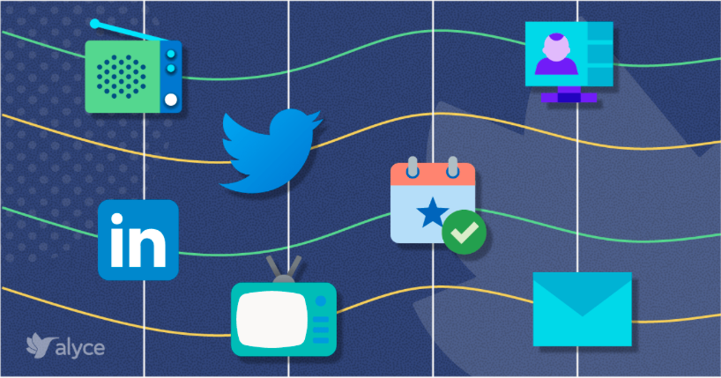
Data and Tools Used
What other data would you have liked to have in an ideal scenario?
Lead source of acquisition channel to assist the Marketing team on strategy of most profitable channels and expansion into further channels
Which tools did you use to undertake the processing and statistical analysis?
Microsoft Excel & SQL
Where did you find the dataset?
Our dataset was found on Kaggle.com
Did you have to join multiple datasets in order to create the ideal dataset?
No, however our dataset had to be cleaned, and variables e.g. purchase date and purchase id added so that we could build a relational database
Notes:
Barbara

Slide 6
Data Processing
What did you do to refine your data: outline your process.
Inspected column types, nulls, and row counts across tables
Removed duplicates using DISTINCT and ROW_NUMBER() on product attributes
Validated joins between purchases, products, and customers
Standardized inconsistent values and normalized categories
Parsed purchase_date into MONTH() and YEAR() for seasonal analysis
Outliers. How did you determine outliers in your dataset? What thresholds did you set? Did you have to make any additional assumptions?
Flagged outliers in purchase amount, rating, and purchase count
Set business rules (e.g., purchase count > 50) for additional flags
Preserved valid outliers unless clearly erroneous or duplicated

Slide 7
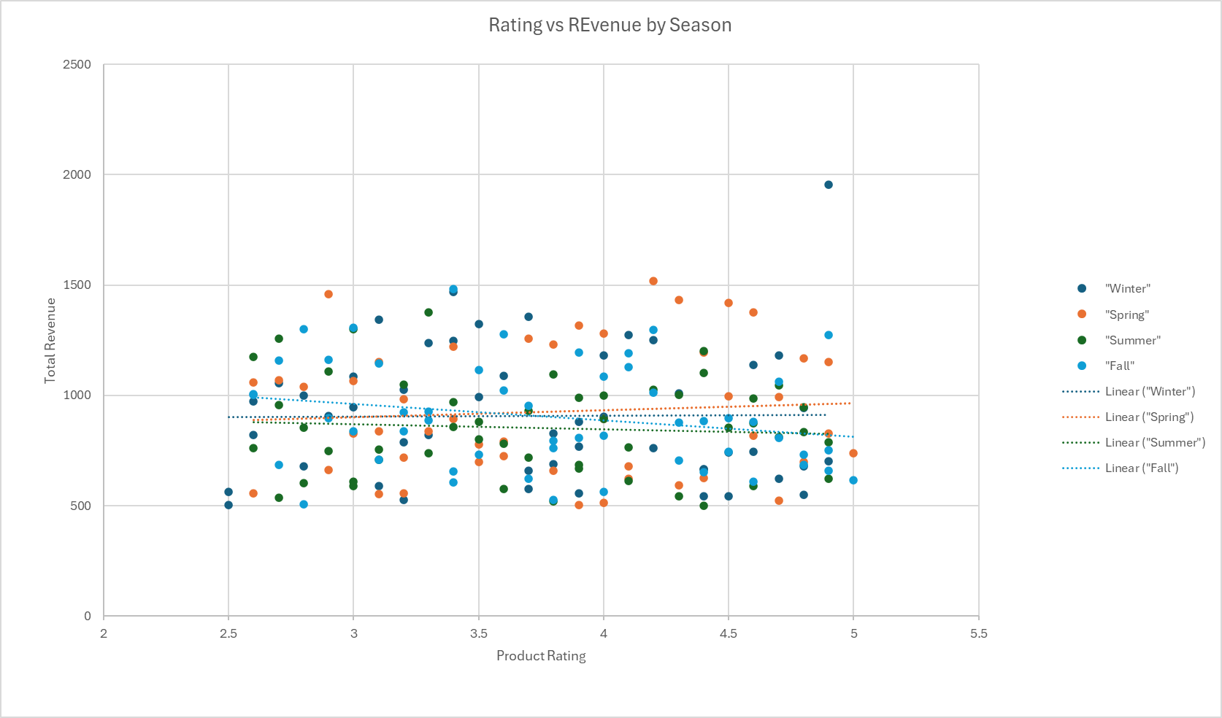
Data Processing
Were there any surprising insights from your data processing/exploration?
Outerwear peaked in summer, dipped in fall
Jewelry dominated spring purchases
Younger users favored digital payments
High ratings didn’t always mean high sales
Plots showing these insights? These can be visuals exported from Tableau.

Slide 8
Statistical Analysis
An overview of the different statistical analyses performed, and why they were chosen.
Descriptive statistics for purchase behavior
Aggregation by category, season, and demographic
Seasonal alignment logic
Note: Feel free to make multiple slides to discuss each one in more detail.

Slide 9
Older customers tend to spend more per purchase than younger customers.
Customers aged 46-55 have the most disposable income as they have spent the most in total purchases
Age_Group | Total_purchase_amount
18-25 | $ 34,630.00
26-35 | $ 44,342.00
36-45 | $ 43,234.00
46-55 | $ 45,619.00
56-65 | $ 44,352.00
66+ | $ 20,904.00

Slide 10
Do subscribed customers purchase more frequently?
Average purchase count stands at 26.08 for subscribed customers vs. 25.08 for unsubscribed.
Customer_subscription | Avg_purchase_count
Subcribed | 26.0845
Unsubscribed | 25.0804

Slide 11
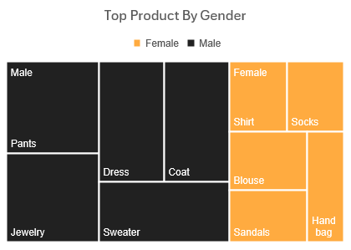
Do product preferences vary by gender?
Product category preferences vary significantly by gender (e.g., tech vs. apparel).
Customer_gender | Product_category | Product_item | Purchase_count
Female | Clothing | Blouse | 66
Female | Footwear | Sandals | 59
Female | Clothing | Shirt | 59
Female | Clothing | Socks | 58
Female | Accessories | Handbag | 58
Male | Clothing | Pants | 123
Male | Accessories | Jewelry | 119
Male | Clothing | Dress | 114
Male | Outerwear | Coat | 114
Male | Clothing | Sweater | 114

Slide 12
Are seasonal products purchased more during their season?
Products labeled as “summer” or “winter” show seasonal spikes in purchase amount.
Seasons | Total_Purchase
Fall | 975
Winter | 971
Spring | 999
Summer | 955

Slide 13
Do higher-rated products sell more?
Higher-rated products are purchased more frequently and generate higher revenue.

Slide 14
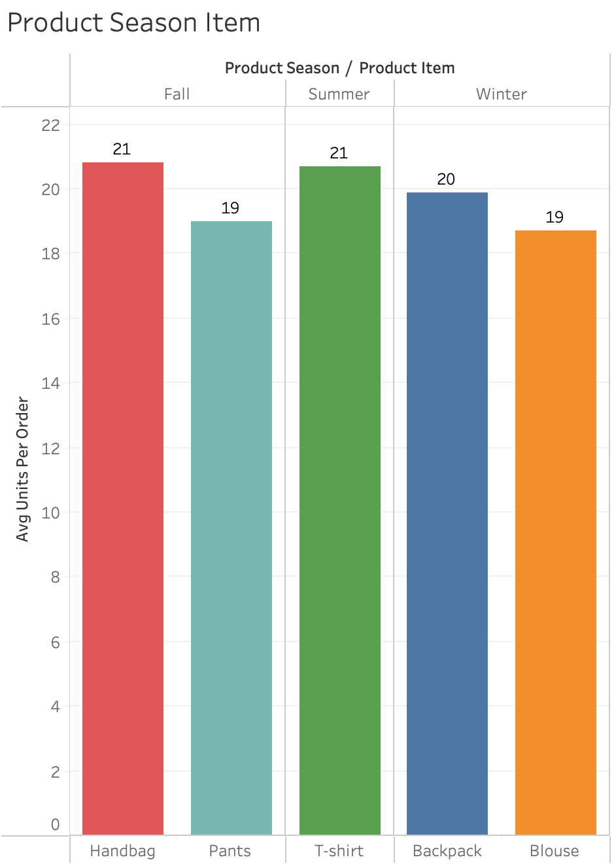
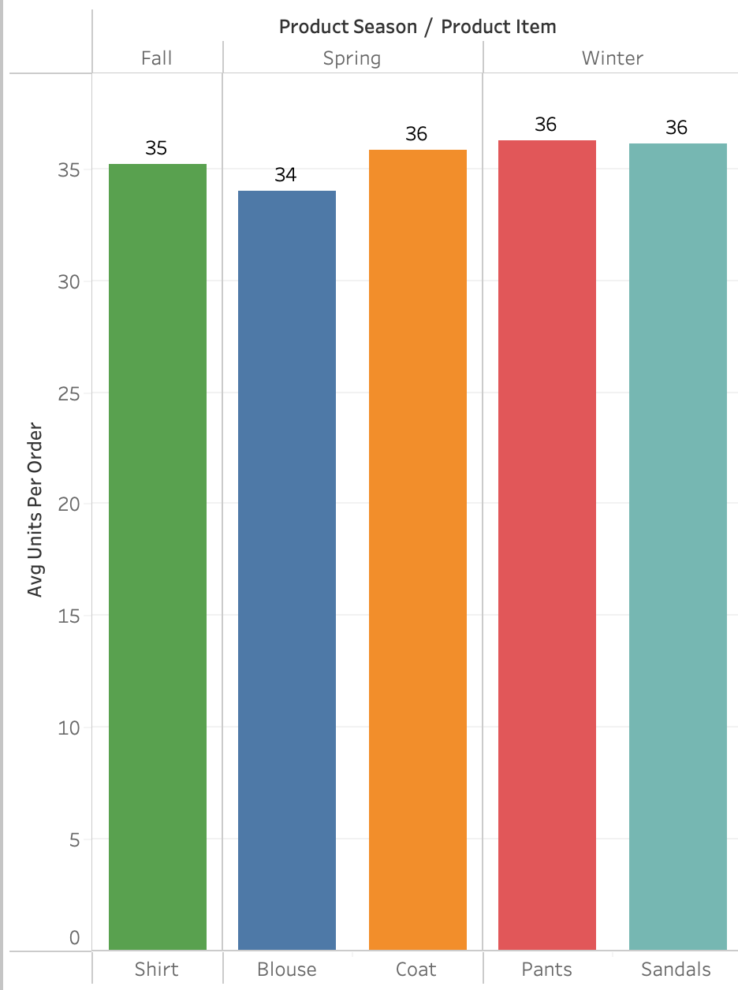
Rewards program based on subscriber seasonal purchasing patterns
Notes:
Barbara

Slide 15
Insights Discussion
What were the main insights from the Statistical Analyses
Note: Using visuals to discuss these would be ideal. These can be visuals exported from Tableau

Slide 16
Summary Conclusions
Was your expected Hypothesis confirmed or not?
Did the problem get solved from your analysis?
If not, then where do you think the issue happened.
Note: A Hypothesis not getting confirmed is not a failure. It is a scientific method of improving understanding. Be comfortable with negative results as they are just as important in informing decisions!

Slide 17
Key Learnings
What would you change in this project process if you could do this all over again?

Slide 18
Thank You

Slide 19
Appendix

Slide 20
References
References for the entire workflow can go here or in Speaker Notes per slide.

